Slide 1
Data Communication and Computer Networks
Diljith K Benny

Slide 2
Module 1

Slide 3
Introduction
DATA COMMUNICATIONS
Data communications are the exchange of data between two devices via some form of transmission medium such as a wire cable.
The effectiveness of a data communications system depends on four fundamental characteristics:
Delivery
Accuracy
Timeliness
Jitter

Slide 4
Introduction
COMPONENTS
A data communications system has five components:
Message
Sender
Receiver
Transmission Medium
Protocol

Slide 5
Introduction
Data Representation
Text
Numbers
Images
Audio
Video

Slide 6
Introduction
Data Flow
Communication between two devices can be simplex, half-duplex, or full-duplex.
In simplex mode, the communication is unidirectional, as on a one-way street. Only one of the two devices on a link can transmit; the other can only receive.
Keyboards and traditional monitors are examples of simplex devices.

Slide 7
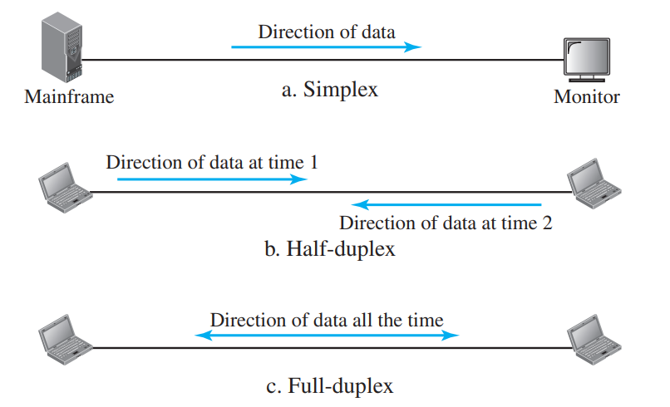

Slide 8
Introduction
In half-duplex mode, each station can both transmit and receive, but not at the same time. When one device is sending, the other can only receive, and vice versa.
The half-duplex mode is like a one-lane road with traffic allowed in both directions. When cars are traveling in one direction, cars going the other way must wait.
In a half-duplex transmission, the entire capacity of a channel is taken over by whichever of the two devices is transmitting at the time.
Walkie-talkies and CB (citizens band) radios are both half-duplex systems.

Slide 9
Introduction
In full-duplex mode (also called duplex), both stations can transmit and receive simultaneously.
full-duplex mode is like a two-way street with traffic flowing in both directions at the same time.
In full-duplex mode, signals going in one direction share the capacity of the link with signals going in the other direction.
This sharing can occur in two ways: Either the link must contain two physically separate transmission paths, one for sending and the other for receiving; or the capacity of the channel is divided between signals traveling in both directions.
One common example of full-duplex communication is the telephone network. When two people are communicating by a telephone line, both can talk and listen at the same time.

Slide 10
Introduction
NETWORKS
A network is the interconnection of a set of devices capable of communication.
A device can be a host(or an end system as it is sometimes called) such as a large computer, desktop, laptop, workstation, cellular phone, or security system.
A device in this definition can also be a connecting device such as a router, which connects the network to other networks, a switch, which connects devices together, a modem (modulator-demodulator), which changes the form of data, and so on.

Slide 11
Introduction
Network Criteria
Performance
Performance is often evaluated by two networking metrics: throughput and delay. We often need more throughput and less delay. However, these two criteria are often contradictory. If we try to send more data to the network, we may increase throughput but we increase the delay because of traffic congestion in the network.
Reliability
In addition to accuracy of delivery, network reliability is measured by the frequency of failure, the time it takes a link to recover from a failure, and the network’s robustness in a catastrophe.

Slide 12
Introduction
Network Criteria
Security
Network security issues include protecting data from unauthorized access, protecting data from damage and development, and implementing policies and procedures for recovery from breaches and data losses.

Slide 13
Network Models
PROTOCOL LAYERING
In data communication and networking, a protocol defines the rules that both the sender and receiver and all intermediate devices need to follow to be able to communicate effectively.
When communication is simple, we may need only one simple protocol; when the communication is complex, we may need to divide the task between different layers, in which case we need a protocol at each layer, or protocol layering.

Slide 14
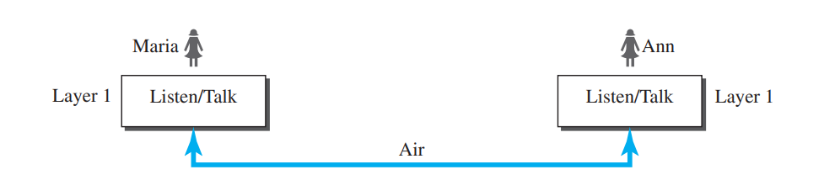
Network Models
Scenarios
In the first scenario, communication is so simple that it can occur in only one layer.

Slide 15
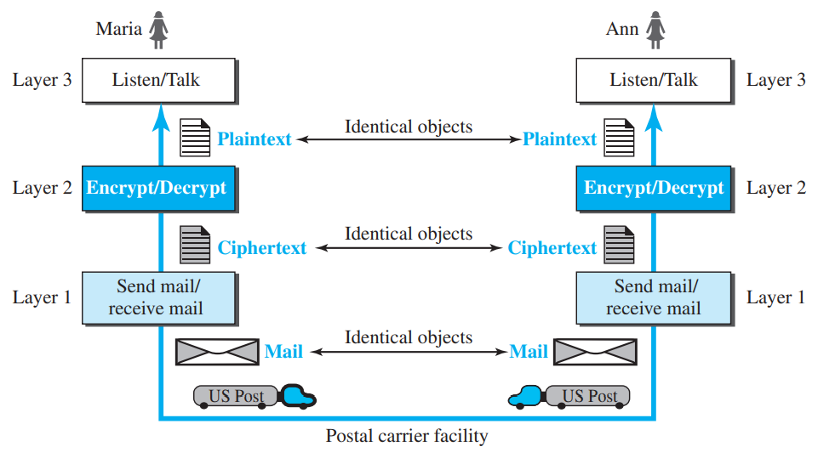
Network Models
Scenario 2:

Slide 16
Principles of Protocol Layering
First Principle
The first principle dictates that if we want bidirectional communication, we need to make each layer so that it is able to perform two opposite tasks, one in each direction.
For example, the third layer task is to listen (in one direction) and talk (in the other direction).
The second layer needs to be able to encrypt and decrypt. The first layer needs to send and receive mail

Slide 17
Principles of Protocol Layering
Second Principle
The second principle that we need to follow in protocol layering is that the two objects under each layer at both sites should be identical.
For example, the object under layer 3 at both sites should be a plaintext letter. The object under layer 2 at both sites should be a ciphertext letter. The object under layer 1 at both sites should be a piece of mail.

Slide 18
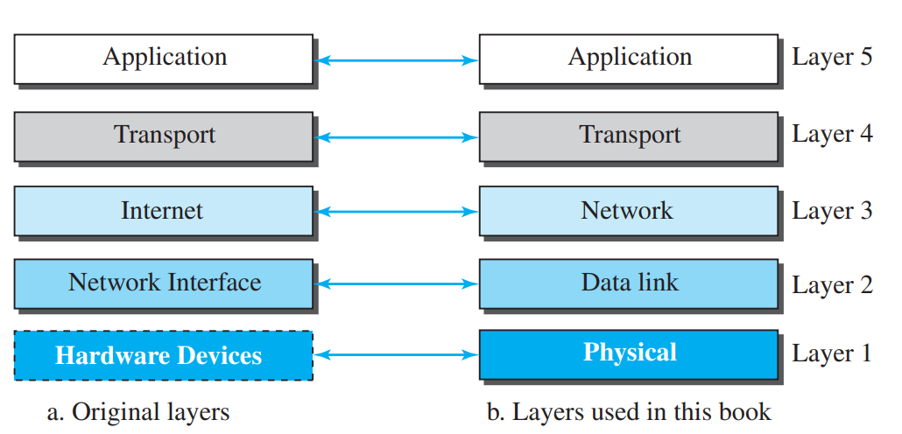
Layers in TCP/IP protocol suite

Slide 19
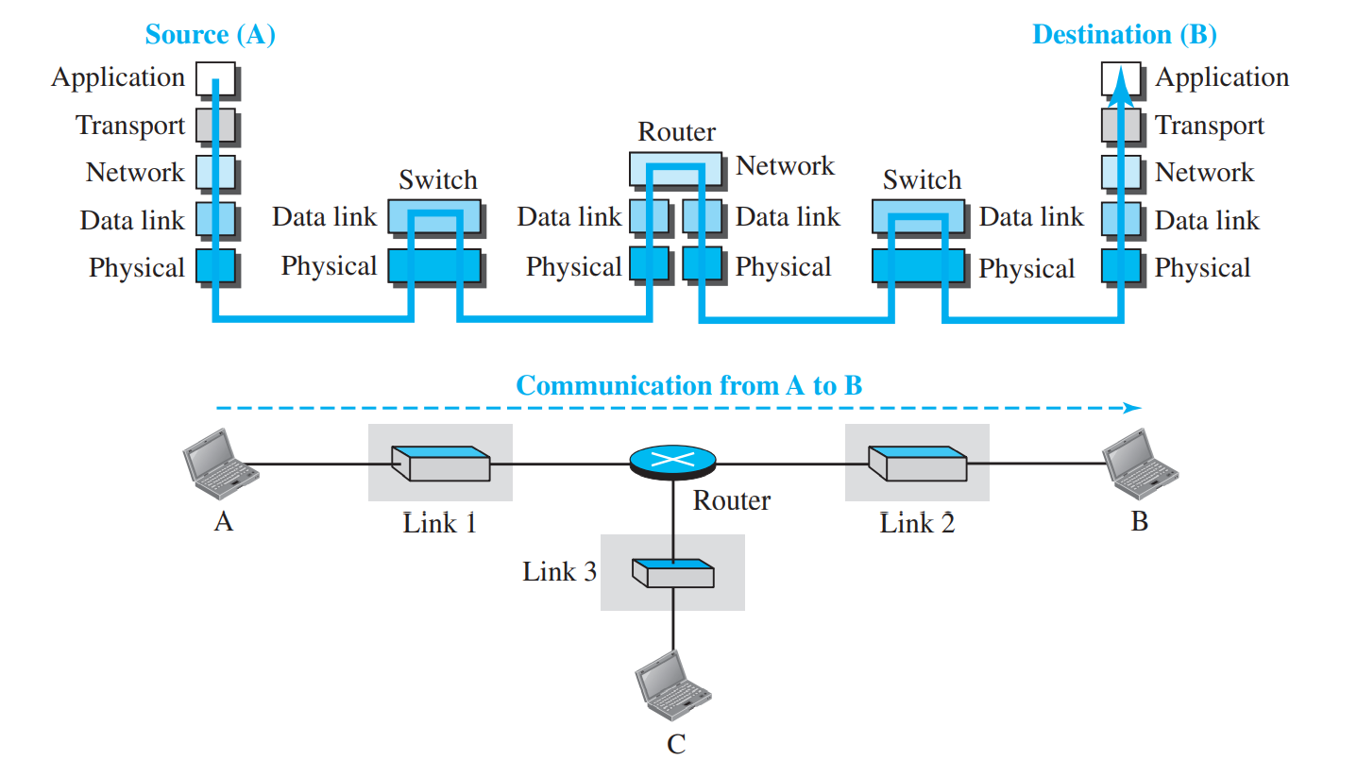
Communication through Internet

Slide 20
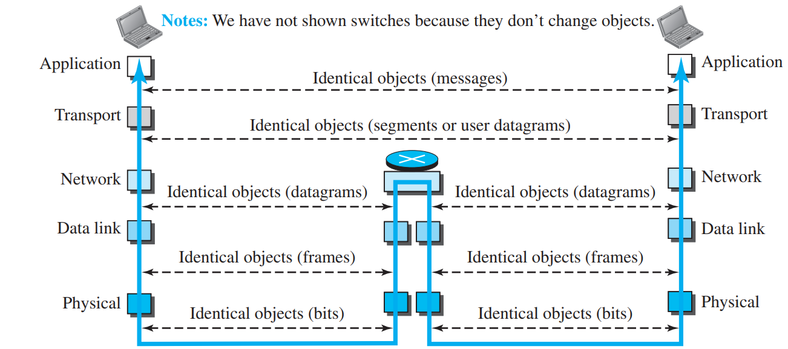
Identical Objects in the TCP/IP protocol suite

Slide 21
Description of each layer
Physical Layer
The physical layer is responsible for carrying individual bits in a frame across the link.
There is another, hidden layer, the transmission media, under the physical layer.
Two devices are connected by a transmission medium (cable or air).
The transmission medium does not carry bits; it carries electrical or optical signals.So the bits received in a frame from the data-link layer are transformed and sent through the transmission media, but we can think that the logical unit between two physical layers in two devices is a bit.
The protocols transforms a bit to signals

Slide 22
Description of each layer
Data Link Layer
An internet is made up of several links (LANs and WANs) connected by routers.
There may be several overlapping sets of links that a datagram can travel from the host to the destination. The routers are responsible for choosing the best links.
When the next link to travel is determined by the router, the data-link layer is responsible for taking the datagram and moving it across the link.
The link can be a wired LAN with a link-layer switch, a wireless LAN, a wired WAN, or a wireless WAN.
We can also have different protocols used with any link type. In each case, the data-link layer is responsible for moving the packet through the link.
The data-link layer takes a datagram and encapsulates it in a packet called a frame.

Slide 23
Description of each layer
Network Layer
The network layer is responsible for creating a connection between the source computer and the destination computer.
The communication at the network layer is host-to-host.
Since there can be several routers from the source to the destination, the routers in the path are responsible for choosing the best route for each packet.
The network layer is responsible for host-to-host communication and routing the packet through possible routes.

Slide 24
Description of each layer
Network Layer
The network layer in the Internet includes the main protocol, Internet Protocol (IP), that defines the format of the packet, called a datagram at the network layer.
IP also defines the format and the structure of addresses used in this layer.
IP is also responsible for routing a packet from its source to its destination, which is achieved by each router forwarding the datagram to the next router in its path.
IP is a connectionless protocol that provides no flow control, no error control, and no congestion control services. This means that if any of theses services is required for an application, the application should rely only on the transport-layer protocol.
The network layer also includes unicast (one-to-one) and multicast (one-to-many) routing protocols.
A routing protocol does not take part in routing (it is the responsibility of IP), but it creates forwarding tables for routers to help them in the routing process.

Slide 25
Description of each layer
Network Layer
The network layer also has some auxiliary protocols that help IP in its delivery and routing tasks.
The Internet Control Message Protocol (ICMP) helps IP to report some problems when routing a packet.
The Internet Group Management Protocol (IGMP) is another protocol that helps IP in multitasking.
The Dynamic Host Configuration Protocol (DHCP) helps IP to get the network-layer address for a host.
The Address Resolution Protocol (ARP) is a protocol that helps IP to find the link-layer address of a host or a router when its network-layer address is given.

Slide 26
Description of each layer
Transport Layer
The logical connection at the transport layer is also end-to-end.
The transport layer at the source host gets the message from the application layer, encapsulates it in a transport layer packet (called a segment or a user datagram in different protocols) and sends it, through the logical (imaginary) connection, to the transport layer at the destination host.
The transport layer is responsible for giving services to the application layer: to get a message from an application program running on the source host and deliver it to the corresponding application program on the destination host.

Slide 27
Description of each layer
Transport Layer
The main protocol, Transmission Control Protocol (TCP), is a connection-oriented protocol that first establishes a logical connection between transport layers at two hosts before transferring data. It creates a logical pipe between two TCPs for transferring a stream of bytes.
TCP provides flow control (matching the sending data rate of the source host with the receiving data rate of the destination host to prevent overwhelming the destination),
error control (to guarantee that the segments arrive at the destination without error and resending the corrupted ones),
and congestion control to reduce the loss of segments due to congestion in the network.

Slide 28
Description of each layer
Transport Layer
The other common protocol, User Datagram Protocol (UDP), is a connectionless protocol that transmits user datagrams without first creating a logical connection.
In UDP, each user datagram is an independent entity without being related to the previous or the next one (the meaning of the term connectionless).
UDP is a simple protocol that does not provide flow, error, or congestion control.

Slide 29
Description of each layer
Application Layer
The logical connection between the two application layers is end to-end.
The two application layers exchange messages between each other as though there were a bridge between the two layers.
However, we should know that the communication is done through all the layers.
Communication at the application layer is between two processes (two programs running at this layer).
To communicate, a process sends a request to the other process and receives a response.
Process-to-process communication is the duty of the application layer.

Slide 30
Description of each layer
Application Layer
The Hypertext Transfer Protocol (HTTP) is a vehicle for accessing the World Wide Web (WWW).
The Simple Mail Transfer Protocol (SMTP) is the main protocol used in electronic mail (e-mail) service.
The File Transfer Protocol (FTP) is used for transferring files from one host to another.
The Terminal Network (TELNET) and Secure Shell (SSH) are used for accessing a site remotely.
The Simple Network Management Protocol (SNMP) is used by an administrator to manage the Internet at global and local levels.
The Domain Name System (DNS) is used by other protocols to find the network-layer address of a computer.
The Internet Group Management Protocol (IGMP) is used to collect membership in a group.

Slide 31
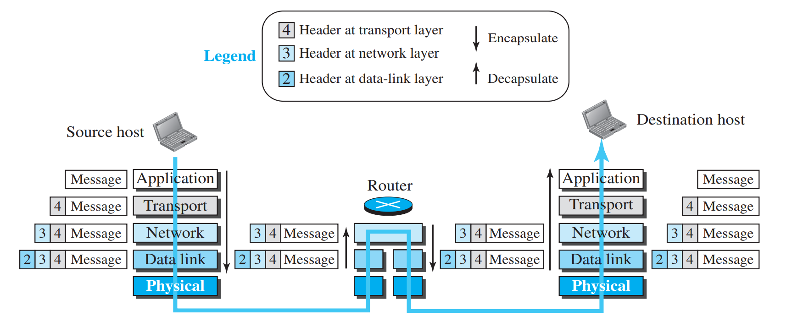
Encapsulation/Decapsulation

Slide 32
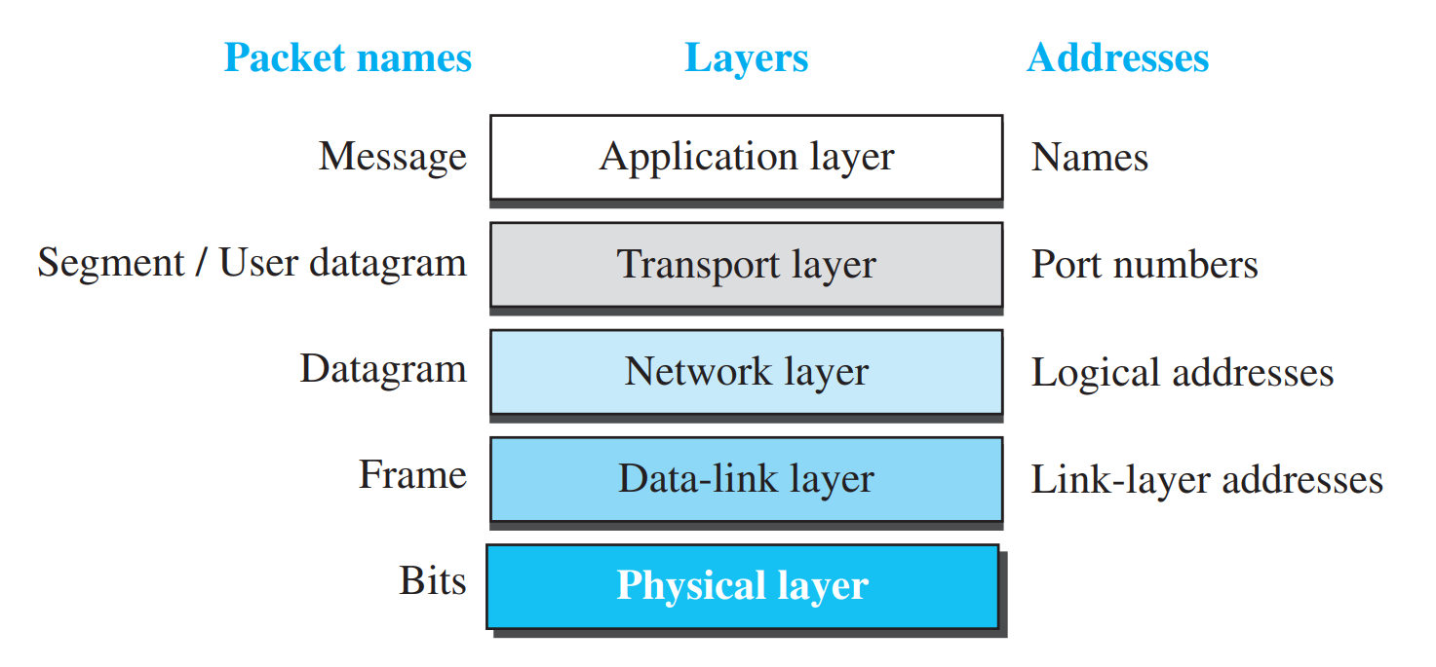
Addressing
Any communication that involves two parties needs two addresses:
Source address and Destination address.

Slide 33
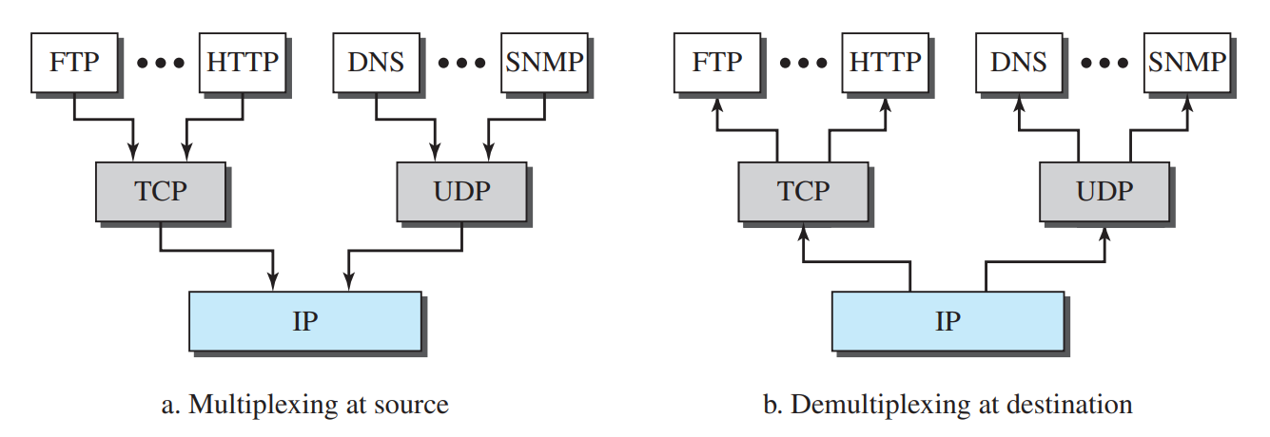
Multiplexing and Demultiplexing

Slide 34
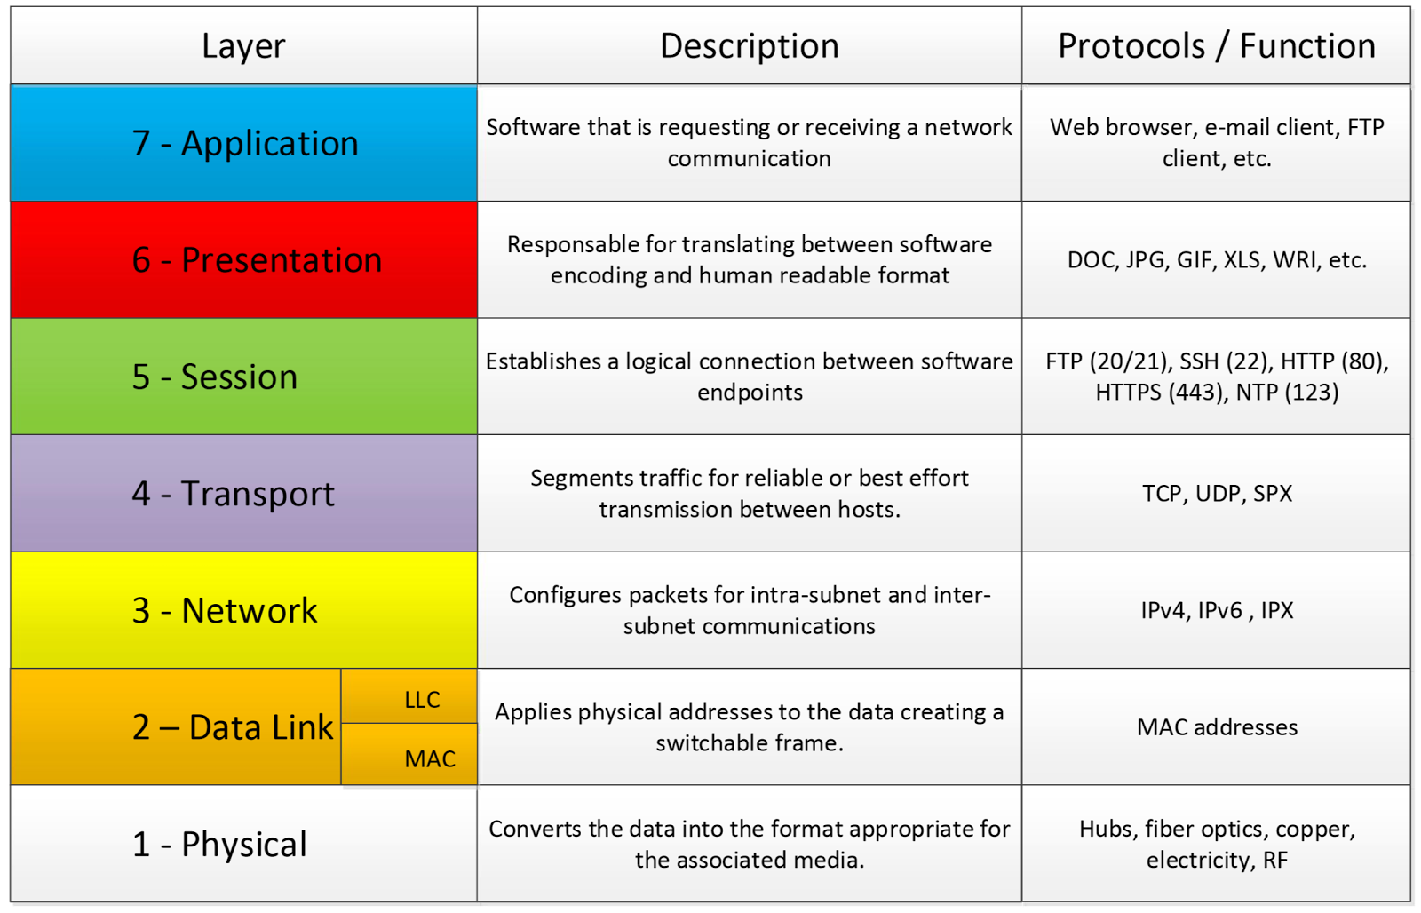
OSI Reference Model

Slide 35
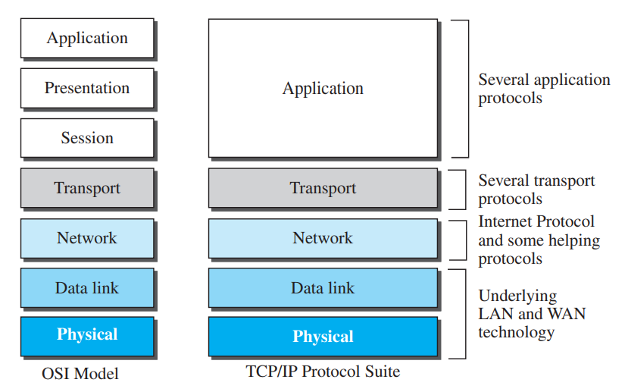
TCP/IP vs ISO/OSI Model

Slide 36
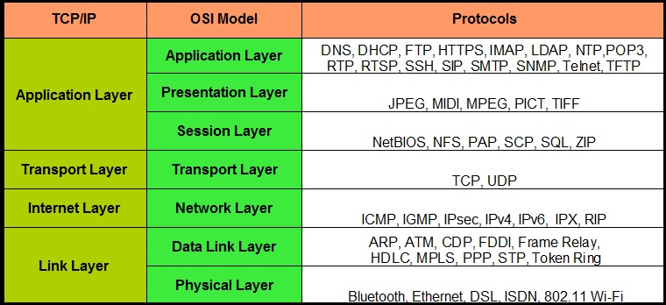

Slide 37
Analog and Digital data
Data can be analog or digital.
The term analog data refers to information that is continuous; digital data refers to information that has discrete states.

Slide 38
Analog and Digital signals
Like the data they represent, signals can be either analog or digital.
An analog signal has infinitely many levels of intensity over a period of time. As the wave moves from value A to value B, it passes through and includes an infinite number of values along its path.
A digital signal, on the other hand, can have only a limited number of defined values. Although each value can be any number, it is often as simple as 1 and 0.

Slide 39
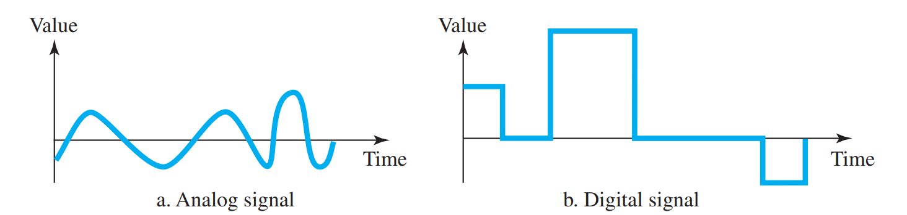
Analog and Digital signals
The simplest way to show signals is by plotting them on a pair of perpendicular axes.
The vertical axis represents the value or strength of a signal. The horizontal axis represents time.

Slide 40
Periodic and Non-periodic
Both analog and digital signals can take one of two forms: periodic or nonperiodic
A periodic signal completes a pattern within a measurable time frame, called a period, and repeats that pattern over subsequent identical periods.
The completion of one full pattern is called a cycle.
A nonperiodic signal changes without exhibiting a pattern or cycle that repeats over time.
In data communications, we commonly use periodic analog signals and non periodic digital signals.

Slide 41
Periodic Analog Signals
Periodic analog signals can be classified as simple or composite.
A simple periodic analog signal, a sine wave, cannot be decomposed into simpler signals.
A composite periodic analog signal is composed of multiple sine waves.

Slide 42
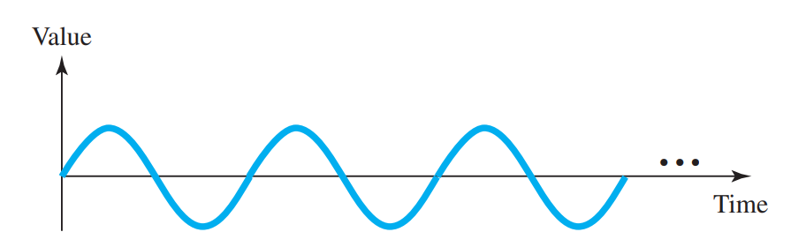
Sine Wave
The sine wave is the most fundamental form of a periodic analog signal.
When we visualize it as a simple oscillating curve, its change over the course of a cycle is smooth and consistent, a continuous, rolling flow.
A Sine wave can be represented by three parameters: the peak amplitude, the frequency, and the phase. These three parameters fully describe a sine wave.

Slide 43
Sine Wave
Peak Amplitude
The peak amplitude of a signal is the absolute value of its highest intensity, proportional to the energy it carries.
For electric signals, peak amplitude is normally measured in volts.
Eg; The voltage of a battery is a constant; this constant value can be considered a sine wave.

Slide 44
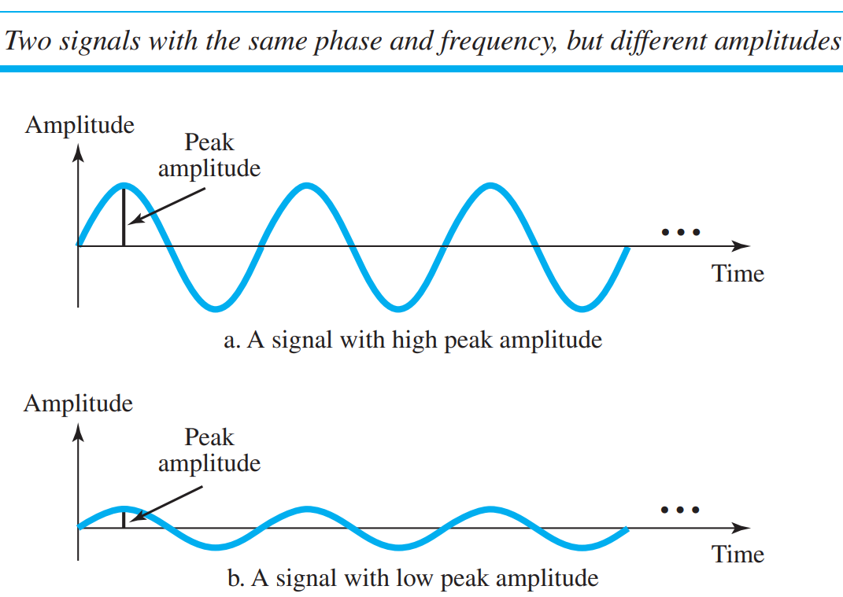

Slide 45
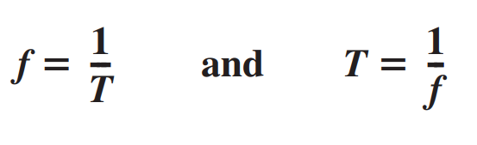
Sine Wave
Period and frequency
Period refers to the amount of time, in seconds, a signal needs to complete 1 cycle.
Frequency refers to the number of periods in 1 s.
Note that period and frequency are just one characteristic defined in two ways.
Period is the inverse of frequency, and frequency is the inverse of period.

Slide 46
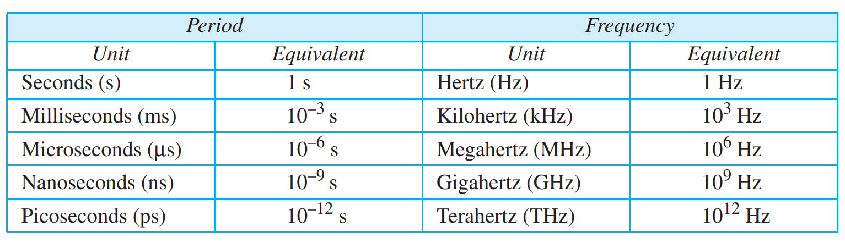
Sine Wave
Units of period and frequency

Slide 47
Sine Wave
Period and frequency
The power we use at home has a frequency of 60 Hz (50 Hz in Europe). Calculate the period of this sine wave.

Slide 48
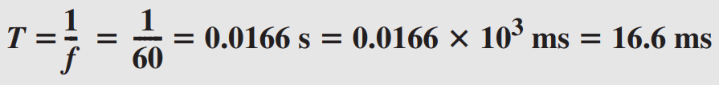
Sine Wave
Period and frequency
The power we use at home has a frequency of 60 Hz (50 Hz in Europe). Calculate the period of this sine wave.

Slide 49
Sine Wave
Period and frequency
Express a period of 100 ms in microseconds.

Slide 50
Sine Wave
Period and frequency
Express a period of 100 ms in microseconds.

Slide 51
Sine Wave
The period of a signal is 100 ms. What is its frequency in kilohertz?

Slide 52
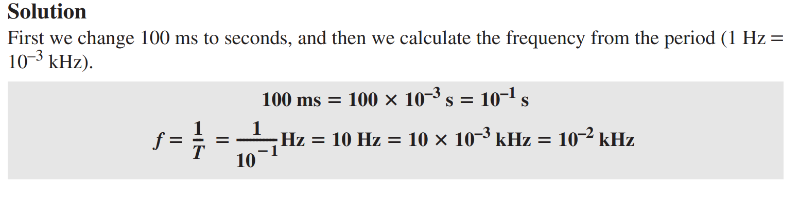
Sine Wave
The period of a signal is 100 ms. What is its frequency in kilohertz?

Slide 53
Phase
The term phase, or phase shift, describes the position of the waveform relative to time 0.
If we think of the wave as something that can be shifted backward or forward along the time axis, phase describes the amount of that shift.
It indicates the status of the first cycle.
Phase describes the position of the waveform relative to time 0.

Slide 54
Phase
Phase is measured in degrees or radians [360° is 2π rad; 1° is 2π/360 rad, and 1 rad is 360/(2π)].
A phase shift of 360° corresponds to a shift of a complete period;
a phase shift of 180° corresponds to a shift of one-half of a period;
and a phase shift of 90° corresponds to a shift of one-quarter of a period.

Slide 55
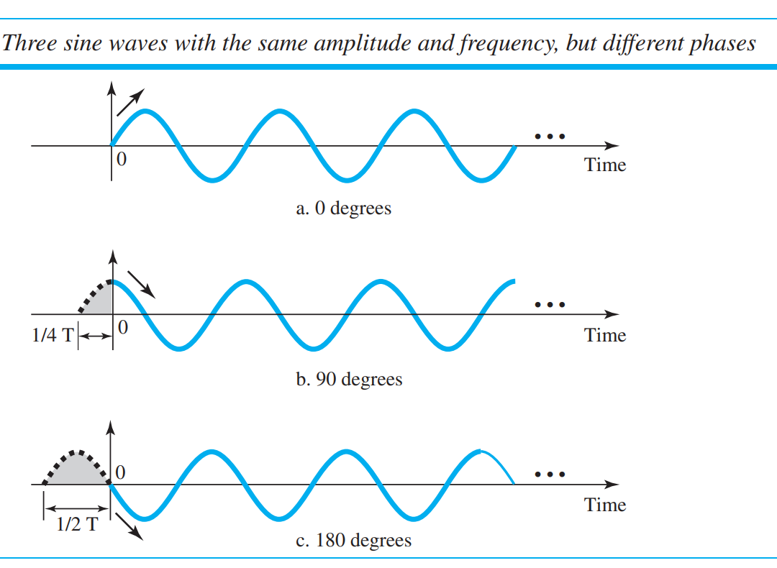

Slide 56
Phase
Looking at Figure, we can say that
A sine wave with a phase of 0° starts at time 0 with a zero amplitude. The amplitude is increasing.
A sine wave with a phase of 90° starts at time 0 with a peak amplitude. The amplitude is decreasing.
A sine wave with a phase of 180° starts at time 0 with a zero amplitude. The amplitude is decreasing.
Another way to look at the phase is in terms of shift or offset. We can say that
A sine wave with a phase of 0° is not shifted.
A sine wave with a phase of 90° is shifted to the left by cycle. However, note that the signal does not really exist before time 0.
A sine wave with a phase of 180° is shifted to the left by cycle. However, note that the signal does not really exist before time 0.

Slide 57
Phase
Example:
A sine wave is offset ⅙ cycle with respect to time 0. What is its phase in degrees and radians?

Slide 58

Phase
Example:
A sine wave is offset ⅙ cycle with respect to time 0. What is its phase in degrees and radians?

Slide 59
Wavelength
Wavelength is another characteristic of a signal traveling through a transmission medium.
Wavelength binds the period or the frequency of a simple sine wave to the propagation speed of the medium.
While the frequency of a signal is independent of the medium, the wavelength depends on both the frequency and the medium.
The wavelength is the distance a simple signal can travel in one period.

Slide 60
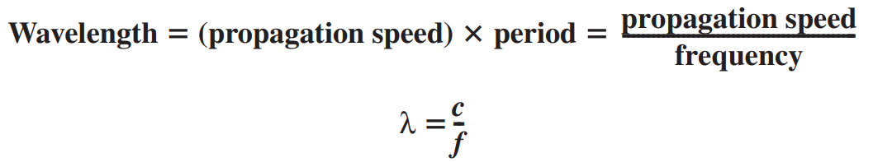
Wavelength
Wavelength can be calculated if one is given the propagation speed (the speed of light) and the period of the signal.
However, since period and frequency are related to each other, if we represent wavelength by λ, propagation speed by c (speed of light), and frequency by f, we get

Slide 61
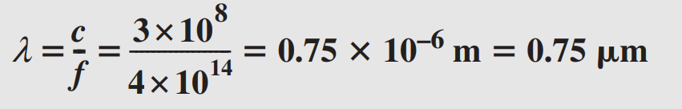
Wavelength
The propagation speed of electromagnetic signals depends on the medium and on the frequency of the signal.
For example, in a vacuum, light is propagated with a speed of 3 × 10^8 m/s. That speed is lower in air and even lower in cable.
The wavelength is normally measured in micrometers (microns) instead of meters.
For example, the wavelength of red light (frequency = 4 × 1014) in air is,

Slide 62
Bandwidth
The range of frequencies contained in a composite signal is its bandwidth.
The bandwidth is normally a difference between two numbers.
For example, if a composite signal contains frequencies between 1000 and 5000, its bandwidth is 5000 − 1000, or 4000.
The bandwidth of a composite signal is the difference between the highest and the lowest frequencies contained in that signal.

Slide 63
DIGITAL SIGNALS
In addition to being represented by an analog signal, information can also be represented by a digital signal.
For example, a 1 can be encoded as a positive voltage and a 0 as zero voltage.
A digital signal can have more than two levels. In this case, we can send more than 1 bit for each level.

Slide 64
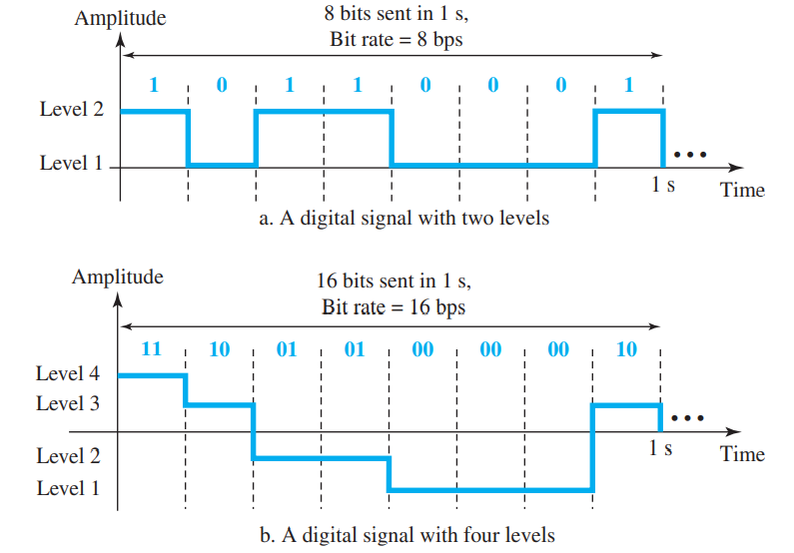

Slide 65
DIGITAL SIGNALS
In general, if a signal has L levels, each level needs log2 L bits.
For this reason, we can send log24 = 2 bits in part b.

Slide 66
Bit Rate
Most digital signals are nonperiodic, and thus period and frequency are not appropriate characteristics.
Another term—bit rate (instead of frequency)—is used to describe digital signals.
The bit rate is the number of bits sent in 1s, expressed in bits per second (bps).

Slide 67
Bit Length
The bit length is the distance one bit occupies on the transmission medium.

Slide 68
Digital Transmission

Slide 69
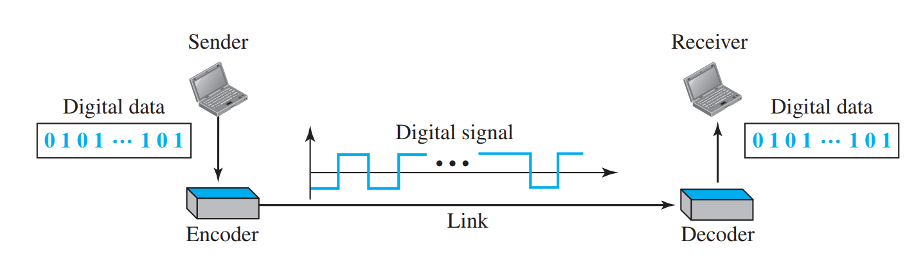
DIGITAL TO DIGITAL CONVERSION
Line Coding
  Line coding is the process of converting digital data to digital signals.
  Line coding converts a sequence of bits to a digital signal.
  At the sender, digital data are encoded into a digital signal; at the receiver, the digital data are recreated by decoding the digital signal.

Slide 70
DIGITAL TO DIGITAL CONVERSION
Characteristics:
Signal Element Versus Data Element
  In data communications, our goal is to send data elements.
  A data element is the smallest entity that can represent a piece of information: this is the bit.
  In digital data communications, a signal element carries data elements.
  A signal element is the shortest unit (timewise) of a digital signal.
  Data elements are what we need to send; signal elements are what we can send. Data elements are being carried; signal elements are the carriers.

Slide 71
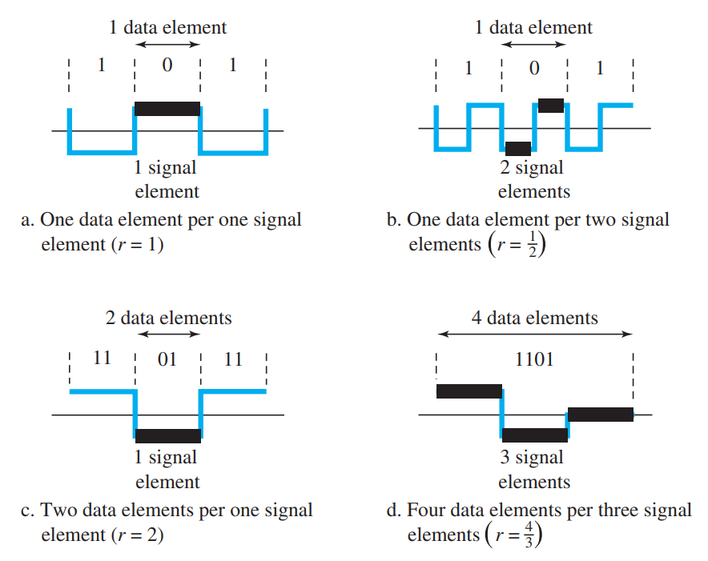

Slide 72
DIGITAL TO DIGITAL CONVERSION
We define a ratio r which is the number of data elements carried by each signal element.
The figure above shows several situations with different values of r.
Suppose each data element is a person who needs to be carried from one place to another. We can think of a signal element as a vehicle that can carry people.
When r = 1, it means each person is driving a vehicle. When r > 1, it means more than one person is travelling in a vehicle (a carpool, for example). We can also have the case where one person is driving a car and a trailer (r = 1/2).

Slide 73
DIGITAL TO DIGITAL CONVERSION
Data Rate Versus Signal Rate:
The data rate defines the number of data elements (bits) sent in 1s.
The unit is bits per second (bps).
The signal rate is the number of signal elements sent in 1s.
The unit is the baud.
The data rate is sometimes called the bit rate; the signal rate is sometimes called the pulse rate, the modulation rate, or the baud rate.

Slide 74
DIGITAL TO DIGITAL CONVERSION
One goal in data communications is to increase the data rate while decreasing the signal rate.
Increasing the data rate increases the speed of transmission; decreasing the signal rate decreases the bandwidth requirement.
Consider the relationship between data rate (N) and signal rate (S)
S = N/r
Here r has been previously defined.
This relationship, of course, depends on the value of r.
It also depends on the data pattern.

Slide 75
DIGITAL TO DIGITAL CONVERSION
We can formulate the relationship between data rate and signal rate as
S_{ave} = c x N x (1/r) baud
where N is the data rate (bps);
c is the case factor, which varies for each case;
S is the number of signal elements per second;
and r is the previously defined factor.

Slide 76
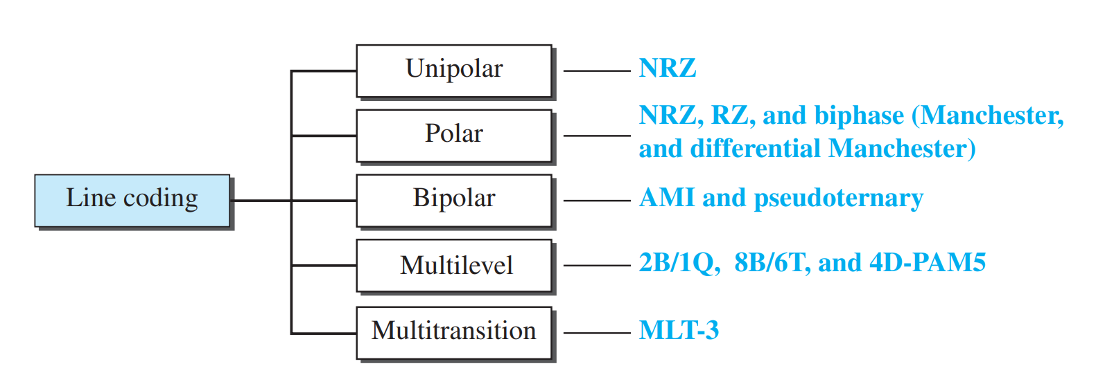
Line Coding Schemes
We can roughly divide line coding schemes into five broad categories.
There are several schemes in each category.

Slide 77
Line Coding Schemes
Unipolar Scheme
In a unipolar scheme, all the signal levels are on one side of the time axis, either above or below.
NRZ (Non-Return-to-Zero)
  Traditionally, a unipolar scheme was designed as a non-return-to-zero (NRZ) scheme in which the positive voltage defines bit 1 and the zero voltage defines bit 0.
  It is called NRZ because the signal does not return to zero at the middle of the bit.

Slide 78
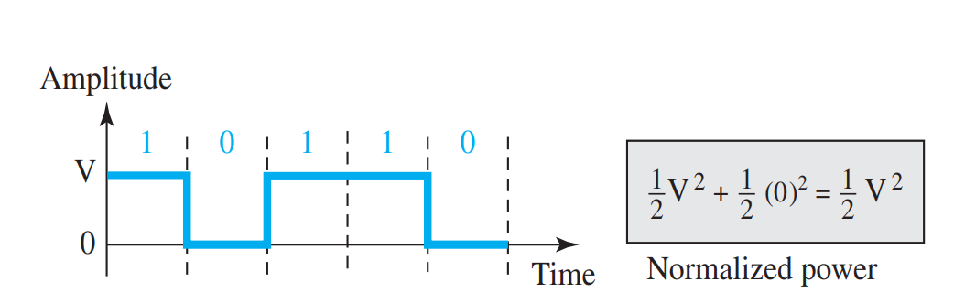
Line Coding Schemes

Slide 79
Line Coding Schemes
Polar Schemes
In polar schemes, the voltages are on both sides of the time axis.
For example, the voltage level for 0 can be positive and the voltage level for 1 can be negative.
  Non-Return-to-Zero (NRZ)
    In polar NRZ encoding, we use two levels of voltage amplitude.
    We can have two versions of polar NRZ: NRZ-L and NRZ-I.

Slide 80
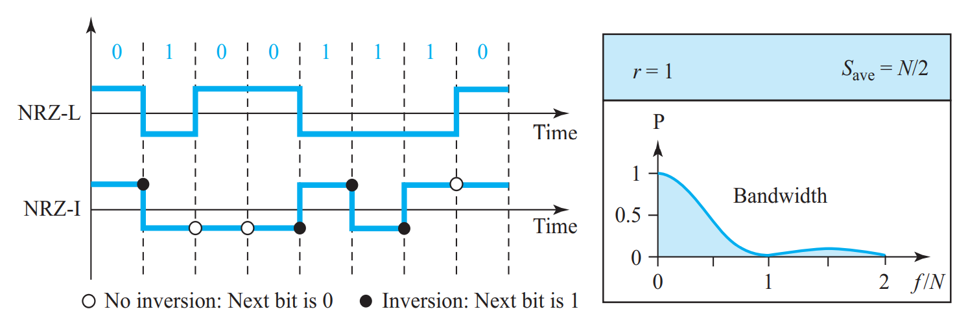
Line Coding Schemes

Slide 81
Non-Return-to-Zero (NRZ)
In the first variation, NRZ-L (NRZ-Level), the level of the voltage determines the value of the bit.
In the second variation, NRZ-I (NRZ-Invert), the change or lack of change in the level of the voltage determines the value of the bit. If there is no change, the bit is 0; if there is a change, the bit is 1.
Both schemes have an average signal rate of N/2 Bd.
In NRZ-L the level of the voltage determines the value of the bit. In NRZ-I the inversion or the lack of inversion determines the value of the bit.

Slide 82
Return-to-Zero (RZ)
The main problem with NRZ encoding occurs when the sender and receiver clocks are not synchronized.
The receiver does not know when one bit has ended and the next bit is starting.
One solution is the return-to-zero (RZ) scheme, which uses three values:
  Positive,
  Negative, and
  Zero.
In RZ, the signal changes not between bits but during the bit.

Slide 83
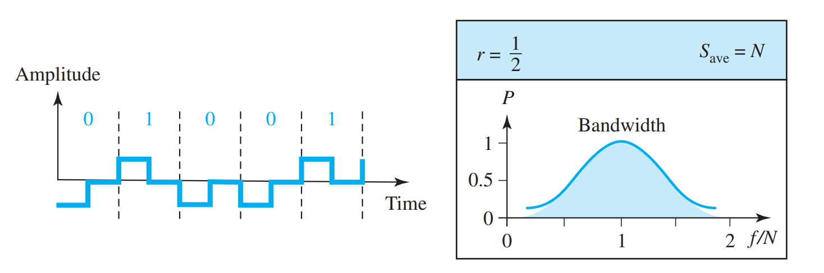
Return-to-Zero (RZ)

Slide 84
Return-to-Zero (RZ)
Here we can see that the signal goes to 0 in the middle of each bit.
It remains there until the beginning of the next bit.
The main disadvantage of RZ encoding is that it requires two signal changes to encode a bit and therefore occupies greater bandwidth.

Slide 85
Return-to-Zero (RZ)
The same problem we mentioned, a sudden change of polarity resulting in all 0s interpreted as 1s and all 1s interpreted as 0s, still exists here, but there is no DC component problem.
Another problem is the complexity: RZ uses three levels of voltage, which is more complex to create and discern.
As a result of all these deficiencies, the scheme is not used today.

Slide 86
Biphase: Manchester and Differential Manchester
The idea of RZ (transition at the middle of the bit) and the idea of NRZ-L are combined into the Manchester scheme.
In Manchester encoding, the duration of the bit is divided into two halves.
The voltage remains at one level during the first half and moves to the other level in the second half.
The transition at the middle of the bit provides synchronization.

Slide 87
Biphase: Manchester and Differential Manchester
Differential Manchester, on the other hand, combines the ideas of RZ and NRZ-I.
There is always a transition at the middle of the bit, but the bit values are determined at the beginning of the bit.
If the next bit is 0, there is a transition; if the next bit is 1, there is none.
The minimum bandwidth of Manchester and differential Manchester is 2 times that of NRZ.

Slide 88
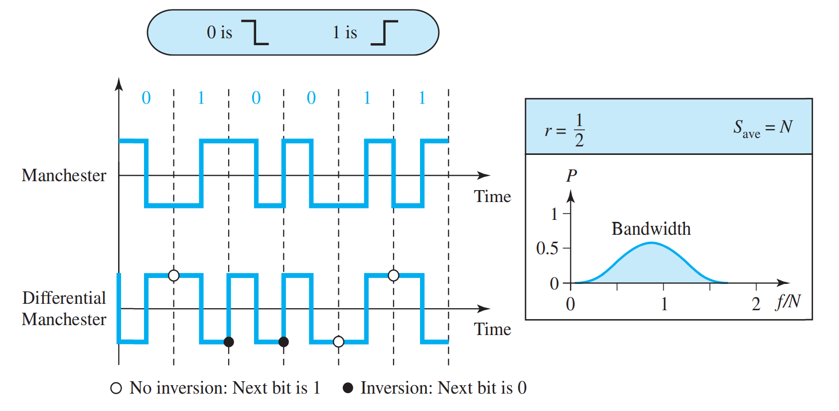
Biphase: Manchester and Differential Manchester

Slide 89
2. Block Coding
We need redundancy to ensure synchronization and to provide some kind of inherent error detecting.
Block coding can give us this redundancy and improve the performance of line coding.
In general, block coding changes a block of m bits into a block of n bits, where n is larger than m.
Block coding is referred to as an mB/nB encoding technique.

Slide 90
ANALOG-TO-DIGITAL CONVERSION
Pulse Code Modulation (PCM)
Delta Modulation (DM)

Slide 91
Pulse Code Modulation (PCM)
The most common technique to change an analog signal to digital data (digitization) is called pulse code modulation (PCM).
The analog signal is sampled.
The sampled signal is quantized.
The quantized values are encoded as streams of bits.

Slide 92
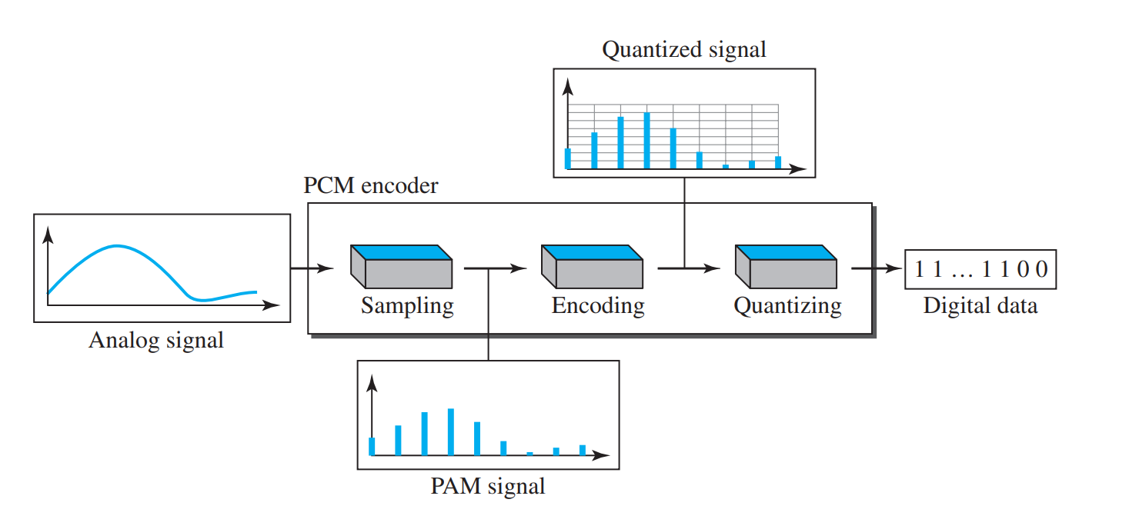
Pulse Code Modulation (PCM)

Slide 93
Pulse Code Modulation (PCM)
Sampling
The first step in PCM is sampling.
The analog signal is sampled every T_{s} s, where T_{s} is the sample interval or period.
The inverse of the sampling interval is called the sampling rate or sampling frequency and denoted by f_{s}, where f_{s} = 1/T_{s}.
There are three sampling methods—ideal, natural, and flat-top.

Slide 94
Pulse Code Modulation (PCM)
In ideal sampling, pulses from the analog signal are sampled.
This is an ideal sampling method and cannot be easily implemented.
In natural sampling, a high-speed switch is turned on for only the small period of time when the sampling occurs.
The result is a sequence of samples that retains the shape of the analog signal.
The most common sampling method, called sample and hold, however, creates flat-top samples by using a circuit.

Slide 95
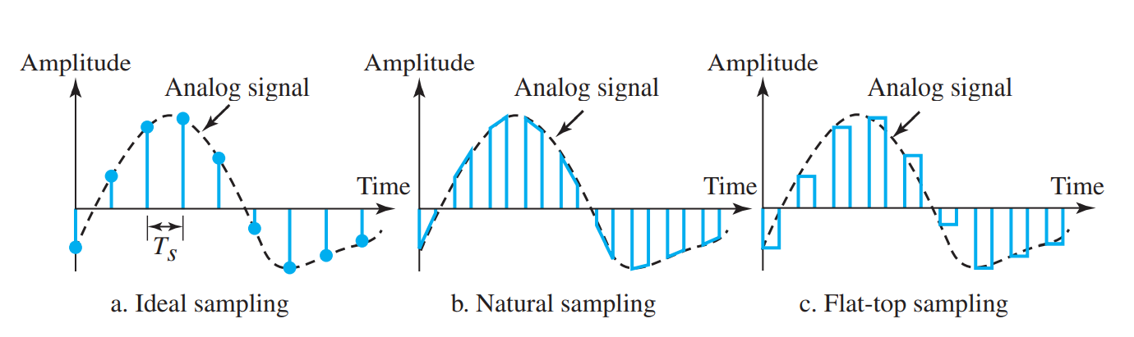
Pulse Code Modulation (PCM)

Slide 96
Pulse Code Modulation (PCM)
Quantization
The result of sampling is a series of pulses with amplitude values between the maximum and minimum amplitudes of the signal.
The set of amplitudes can be infinite with non integral values between the two limits.

Slide 97
Pulse Code Modulation (PCM)
Quantization
These values cannot be used in the encoding process. The following are the steps in quantization:
We assume that the original analog signal has instantaneous amplitudes between V_{min} and V_{max}.
We divide the range into L zones, each of height Δ (delta).
Δ = V_{max} - V_{min}
L

Slide 98
Pulse Code Modulation (PCM)
Quantization
We assign quantized values of 0 to L − 1 to the midpoint of each zone.
We approximate the value of the sample amplitude to the quantized values.
Example, assume that we have a sampled signal and the sample amplitudes are between −20 and +20 V. We decide to have eight levels (L = 8). This means that Δ = 5 V.

Slide 99
Pulse Code Modulation (PCM)
Encoding
The last step in PCM is encoding.
After each sample is quantized and the number of bits per sample is decided, each sample can be changed to an n_{b}-bit code word.
A quantization code of 2 is encoded as 010; 5 is encoded as 101; and so on.
If the number of quantization levels is L, the number of bits is
n_{b} = log₂ L. In our example L is 8 and nb is therefore 3.

Slide 100
Pulse Code Modulation (PCM)
The bit rate can be found from the formula
Bit rate = sampling rate x number of bits per sample
= f_{s} x n_{b}

Slide 101
Delta Modulation (DM)
PCM is a very complex technique.
Other techniques have been developed to reduce the complexity of PCM.
The simplest is delta modulation.
PCM finds the value of the signal amplitude for each sample;
DM finds the change from the previous sample.

Slide 102
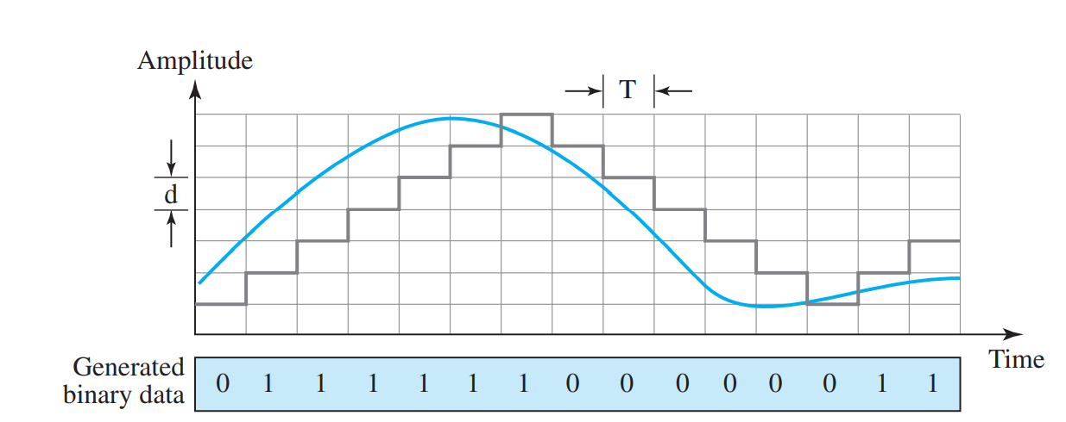
Delta Modulation (DM)

Slide 103
Delta Modulation (DM)
Modulator
The modulator is used at the sender site to create a stream of bits from an analog signal.
The process records the small positive or negative changes, called delta δ.
If the delta is positive, the process records a 1; if it is negative, the process records a 0.
The modulator builds a second signal that resembles a staircase.
Finding the change is then reduced to comparing the input signal with the gradually made staircase signal.

Slide 104
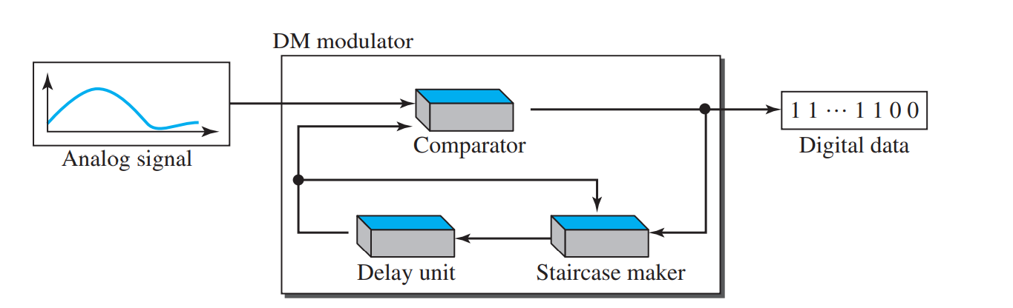
Delta Modulation (DM)

Slide 105
Delta Modulation (DM)
The modulator, at each sampling interval, compares the value of the analog signal with the last value of the staircase signal.
If the amplitude of the analog signal is larger, the next bit in the digital data is 1; otherwise, it is 0.
The output of the comparator, however, also makes the staircase itself.
If the next bit is 1, the staircase maker moves the last point of the staircase signal δ up;
if the next bit is 0, it moves it δ down.

Slide 106
Delta Modulation (DM
Demodulator
The demodulator takes the digital data and, using the staircase maker and the delay unit, creates the analog signal.
The created analog signal, however, needs to pass through a low-pass filter for smoothing.

Slide 107
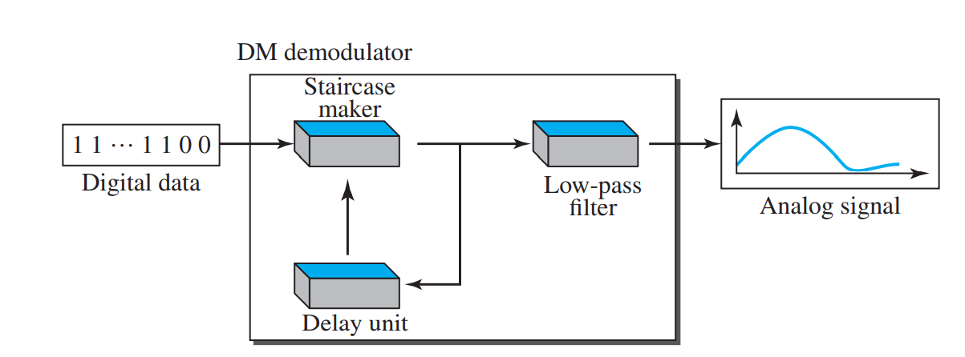
Delta Modulation (DM)

Slide 108
Delta Modulation (DM)
Adaptive DM
A better performance can be achieved if the value of δ is not fixed.
In adaptive delta modulation, the value of δ changes according to the amplitude of the analog signal.

Slide 109
Delta Modulation (DM)
Quantization Error
It is obvious that DM is not perfect. Quantization error is always introduced in the process.
The quantization error of DM, however, is much less than that of PCM.

Slide 110
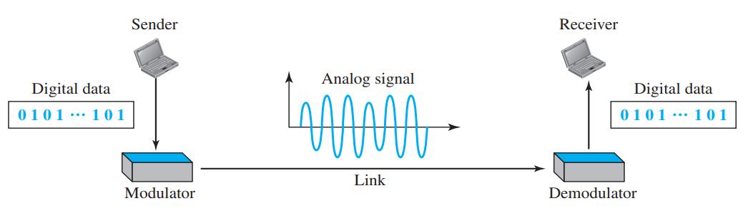
DIGITAL-TO-ANALOG CONVERSION
Digital-to-analog conversion is the process of changing one of the characteristics of an analog signal based on the information in digital data.

